Slide 1
CSE-3213
Computer Graphics Lecture 02

Slide 2
Visualization
Visualization is the process of representing data graphically and interacting with these representations in order to gain insight into the data. By using visual elements like charts, graphs, and maps, data visualization tools provide an accessible way to see and understand trends, outliers, and patterns in data. Traditionally, computer graphics has provided a powerful mechanism for creating, manipulating, and interacting with these representations.

Slide 3
Visualization
Scientists, engineers, medical personnel, business analysts, and others often need to analyze large amounts of information or to study the behavior of certain processes. Numerical simulations carried out on supercomputers frequently produce data files containing thousands and even millions of data values. Similarly, satellite cameras and other sources are amassing large data files faster than they can be interpreted. Scanning these large sets of numbers to determine trends and relationships is a tedious and ineffective process. But if the data are converted to a visual form, the trends and patterns are often immediately apparent. Figure 1 shows an example of a large data set that has been converted to a color-coded display of relative heights above a ground plane. Once we have plotted the density values in this way, we can see easily the overall pattern of the data. Producing graphical representations for scientific, engineering, and medical data sets and processes is generally referred to as scientific visualization. And the term business visualization is used in connection with data sets related to commerce, industry, and other nonscientific areas.

Slide 4
Visualization
Figure 1: A color-coded plot with 16 million density points of relative brightness observed for the Whirlpool Nebula reveals two distinct galaxies.

Slide 5
Image Processing
Image processing is a method to perform some operations on an image, in order to get an enhanced image or to extract some useful information from it. It is a type of signal processing in which input is an image and output may be image or characteristics/features associated with that image.
Two principal applications of image processing are
Improving picture quality and
2. Machine perception of visual information, as used in robotics

Slide 6
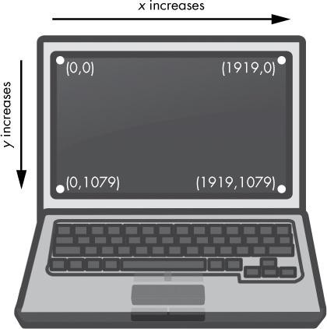
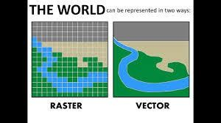
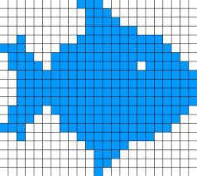
Image Representation
A digital image is composed of discrete pixels. The pixels are arranged in a row and column fashion to form a rectangular area, called as a raster.
Vector graphics are based on mathematical formulas that define geometric primitives such as polygons, lines, curves, circles and rectangles.

Slide 7
Pixel & Resolution
Image space in computer system is not continuous. it consists of set of picture elements called pixels.
Number of pixels per unit length is referred to as the resolution of the image.

Slide 8
Color model
Several color schemes (also called color space, models or formats) have been developed to represent color mathematically.
There are 2 commonly used color schemes :
RGB Color Scheme
CMY Color Scheme

Slide 9
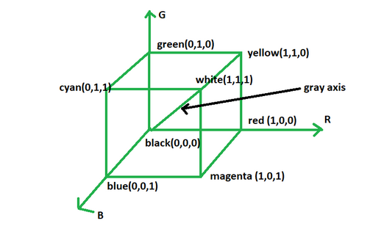
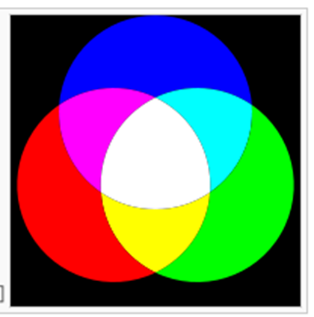
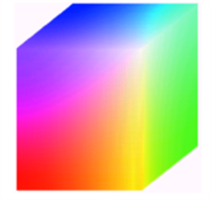
RGB color model
Colors are represented by a numeric triplet specifying R, G and B intensities.
Any color can be defined by giving its R, G and B values, or coordinates, (red, green, blue). This is referred to as an ordered triplet.

Slide 10
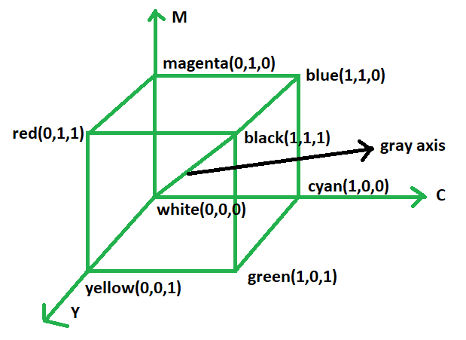
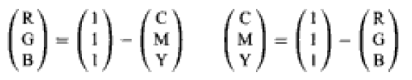
CMY color model
CMY(Cyan, Magenta, Yellow) scheme is widely used for color printing. To print a particular color on a white page, one must apply inks that subtract (absorb) all colors other than the one desired.
Cyan, magenta, and yellow are the subtractive primaries and are the complements of red, green and blue.
Cyan subtracts red from white, and so on. The conversion between RGB and CMY can be done by using :

Slide 11
Thank you

